Slide 1
Systems Analysis and Design CT026-3-1
Coding Standards and Principles

Slide 2
Topic & Structure of The Lesson
Implementation
Coding Standards
Principles of Good Programming

Slide 3
Learning Outcomes
By the end of this lecture, YOU should be able to :
Discuss Coding Standards and Principles
Discuss benefits of coding standards
Discuss good programming practices

Slide 4
Key Terms you must be able to use
If you have mastered this topic, you should be able to use the following terms correctly in your assignments and exams:
Coding best practices
Variable naming
Maintainable code
Bad smells
Refactoring

Slide 5
Coding Standards
Code not only needs to do its job well, but must also be easy to add to, maintain and debug.
Needing to make changes to code could require a lot of energy to decipher lines of code that doesn’t make its purpose or intentions clear.
Neatly commented with details that explain any complicated constructs and the reasoning behind them.

Slide 6
Coding Standards
A coding standards document tells developers how they must write their code.
Avoid each developer coding in their own preferred style
Large project is coded in a consistent style
parts are not written differently by different programmers.

Slide 7
Why do we need coding standards?
Consistent look
Improve readability
Simplifies copying, editing and maintenance
Company wide standardization

Slide 8
Principles of Good Programming
KISS – Keep It Short and Simple
DRY - Don’t Repeat Yourself
Abstraction - Each significant piece of functionality in a program should be implemented in just one place in the source code
Open/Closed Principle - Software entities (classes, modules, functions, etc.) should be open for extension, but closed for modification.
don't write classes that people can modify, write classes that people can extend

Slide 9

Principles of Good Programming
Single Responsibility Principle - A component of code (e.g. class or function) should perform a single well defined task.

Slide 10
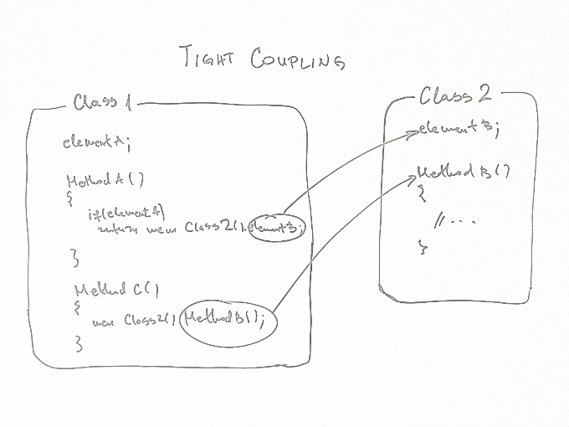
Principles of Good Programming
Minimize Coupling - Any section of code (code block, function, class, etc) should minimize the dependencies on other areas of code.
using shared variables as little as possible.
Maximize Cohesion - Code that has similar functionality should be found within the same component

Slide 11
Naming Conventions
No abbreviations
OnButtonClick vs OnBtnClk
Meaningful names
Intention revealing
int t; //Time to complete single lap
int singleLapTime;

Slide 12
Naming Conventions
Variable Names: Variable names should be in all lowercase, with words separated by an underscore, example: Incorrect:
$currentuser $currentUser
Correct:
$current_user
Names should be descriptive, but concise. We don't want huge sentences as our variable names, but typing an extra couple of characters is always better than wondering what exactly a certain variable is for.

Slide 13
Loop Indices
for ($i = 0; $i < $outer_size; $i++) { for ($j = 0; $j < $inner_size; $j++) { foo($i, $j); } }

Slide 14
Code Smells
Duplicated code
Large classes
Long methods
Long parameter list

Slide 15
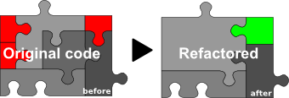
Refactoring
improve your software internal structure in a safe way while not changing / adding / removing behavior or external interfaces.
+readable code, +simplified code, +easier to change, +easier to add new value, +reduced redundancy, advices how to go on to keep-improve software, and last but not least +automatic tests.

Slide 16
Quick Review Question

Slide 17
Summary of Main Teaching Points
Input Design
Coding Standards
Principles of Good Programming

Slide 18
Question and Answer Session
Q & A

Slide 19
What we will cover next
Implementation
Types of testing
Test plan

